Slide 1
Orleans, under the hood
A performance-focused look into the Orleans codebase
@ReubenBond

Slide 2
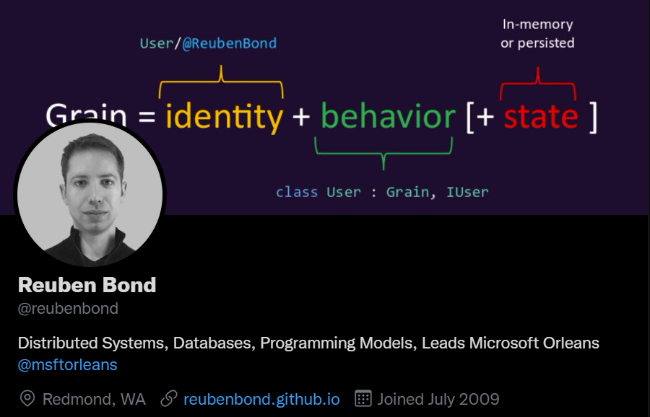

Slide 3
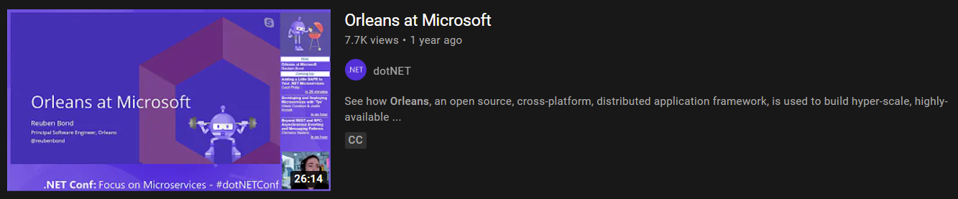
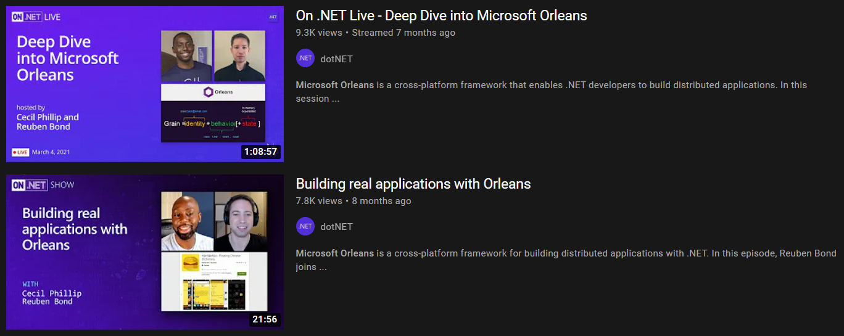
!this.session
… and so on

Slide 4
this.session
Brief tour of Orleans
Quick overview to make things concrete
What makes it fast <– the meat of this talk
RPC – How to build a fast & flexible RPC system
Serialization – How to build a very fast serializer
Code generation – The goop that ties everything together
Generalizable advice for building high-performance systems in .NET!

Slide 5
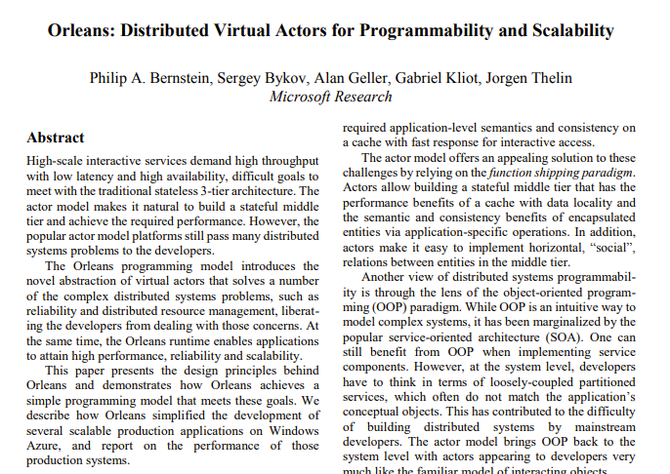
Orleans
.NET framework aimed at making it easier to build cloud-based applications
Mature, used in production by many teams @ MS, etc
Core concept: Grains
Technically: Actors
More accurately: Virtual Actors

Slide 6
Grains – Cloud Native Objects
Treat our cluster like one big machine
Divide our app up into many little objects (Grains)
One for each user profile, shopping cart, game session, chat room, blog post, big compute job, or object in Mixed Reality
Each one gets an id, a class, and some persistent state
Or many pieces of state, or no state (stateless!)
Spread them around our cluster
Load them into memory as needed
Unload them when they’ve become idle
Route messages to them
Every IBlogPost.Get() call for “blog-post/dotnet-perf-tuning” goes to the same object
Make each one single-threaded
Less bugs, no locks, easier to coordinate writes to storage

Slide 7
Grains
Less database reads
Hot/warm data is kept in-memory, cold data is in database
No need for a separate cache – great for soft state
Less database write contention
Each grain owns its own state
Less cache coherency issues
Writes update the grain’s state, grain updates the database
Grains act like a smart, write-through cache
Better scalability
Grains are spread out over your application instances
Low-latency writes
No need for async writes via a queue/worker
Simplicity!
Less code, less infrastructure, less error handling, less retry logic

Slide 8
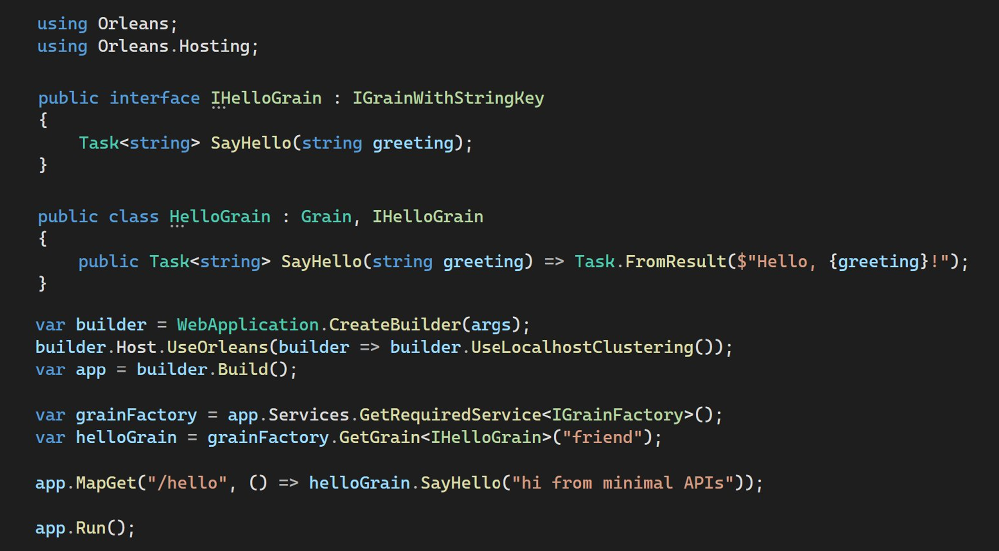
Define a Grain interface
Implement the grain interface
Get a reference to a
grain by type + name
Call the grain

Slide 9
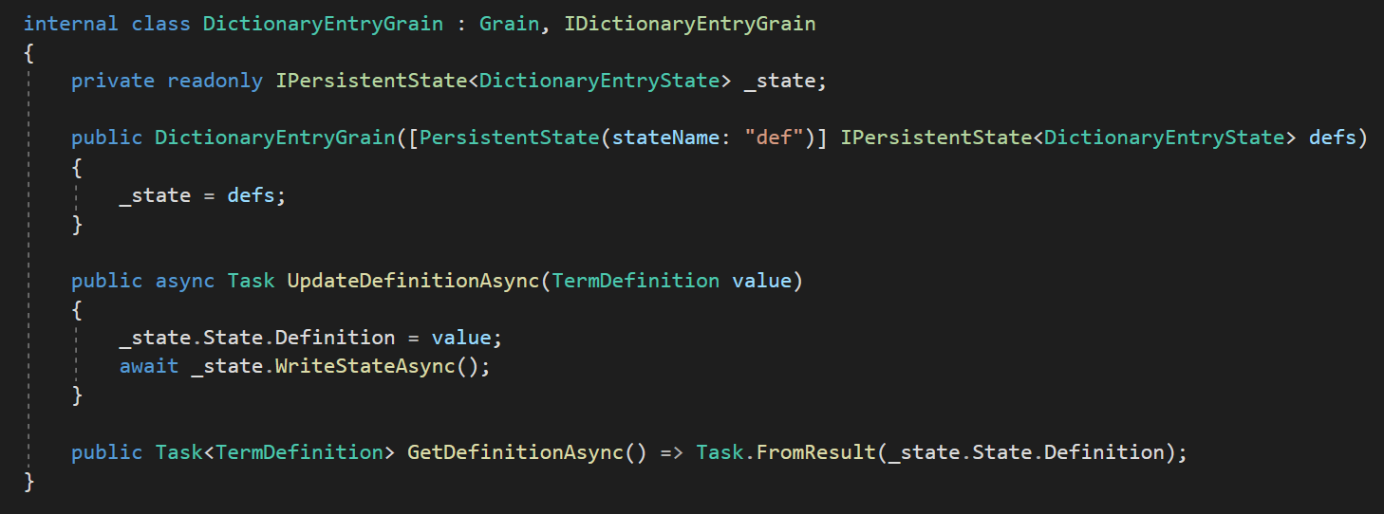
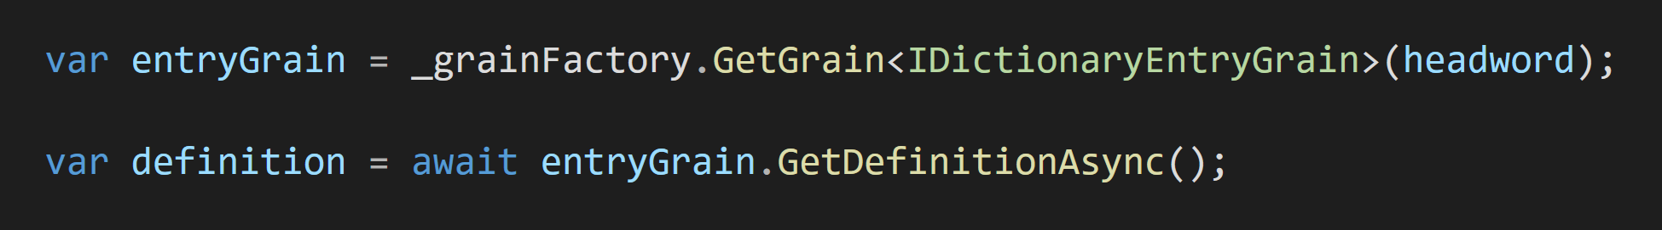
Inject some named state
Database connections are defined at startup time
Update data & write to DB
Fast reads – no database call
Our grain is identified by a dictionary word

Slide 10
What happens behind the scenes
Orleans uses async RPC (Remote Procedure Call)
Like gRPC, but target object instances instead of services, it supports generics, polymorphism, overloads, multiple parameters per method & other .NET niceties
Generates code for each of your interfaces:
One class to turn your method calls into messages
Called a GrainReference. It implements your interface
One class for each interface method, representing a method call and its arguments
Called an “invokable”. It implements IInvokable
When you call GetGrain<T>(id), Orleans gives you an instance of the first class, called a GrainReference
The reference knows the grain type & id, but nothing about where the grain is active right now

Slide 11
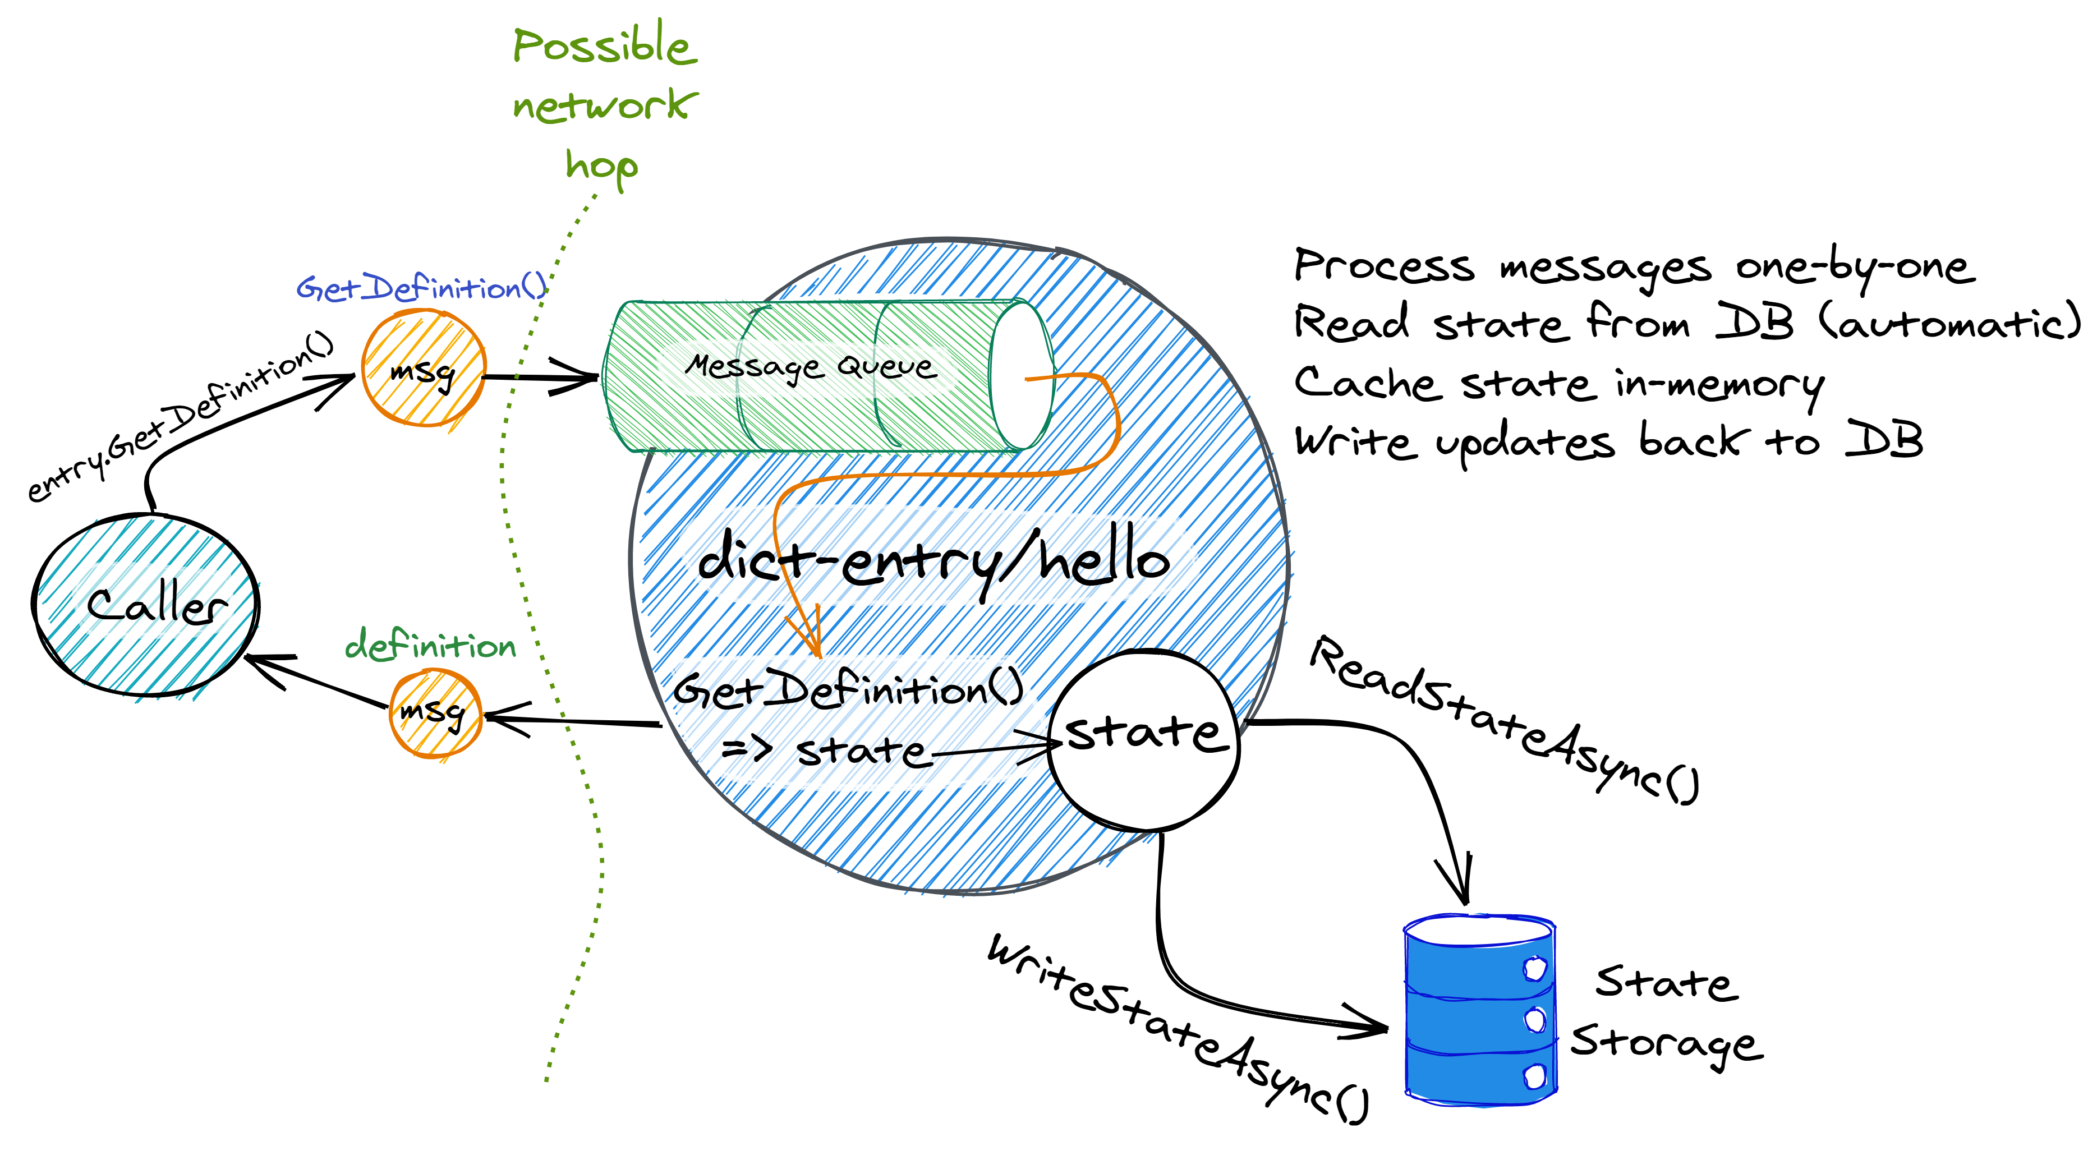

Slide 12
What if the grain isn’t active anywhere?
To find where a grain is Orleans uses a Grain Directory
In-built, or pluggable: Redis, Cosmos DB, etc
Lookups are cached & Orleans handles cache invalidation
If a grain is not active when we call it, Orleans needs to place it somewhere. Placement is customizable:
Place randomly
Place next to the caller
Place on the least-loaded app instance
Place closest to the data the grain will need
Place where your heart desires

Slide 13
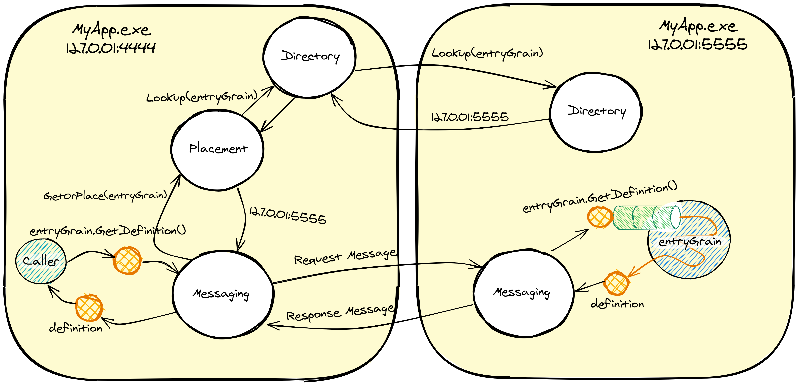

Slide 14
RPC
RPC is very important in Orleans
Any time an interface call needs to cross the process boundary, that involves RPC
Developers should be free model their types/interfaces as they see fit
We want to minimize the amount of ceremony
We do not want magic – only grain interfaces use RPC
Note: the bits are pubternal – you could theoretically use them for interesting RPC and non-RPC things

Slide 15
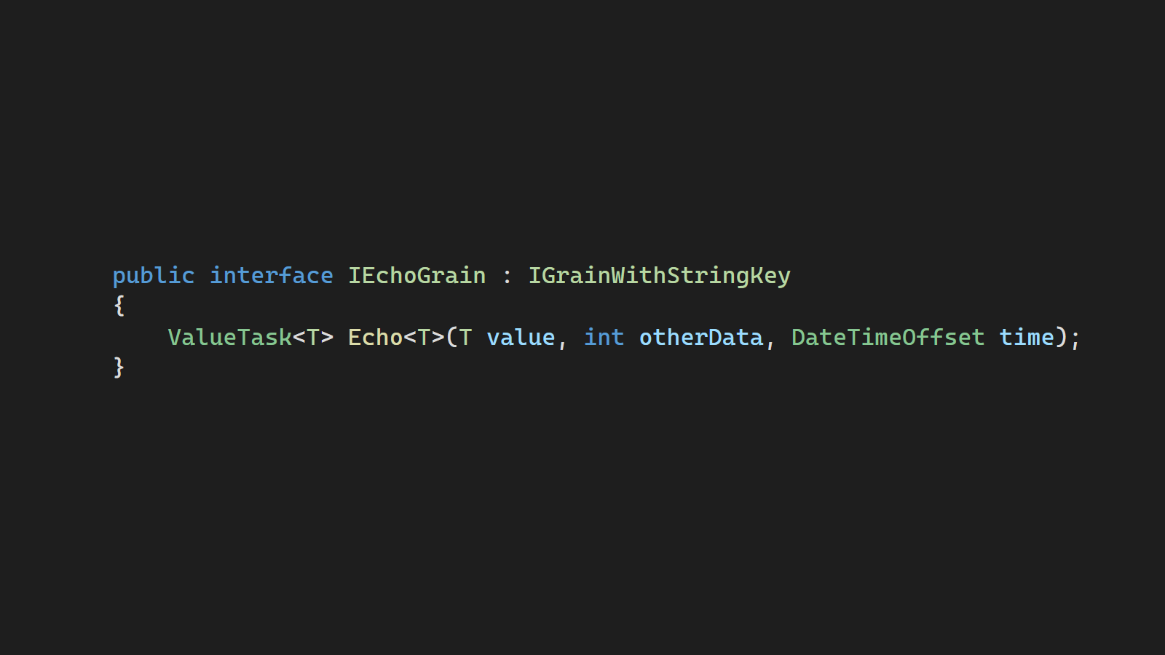

Slide 16
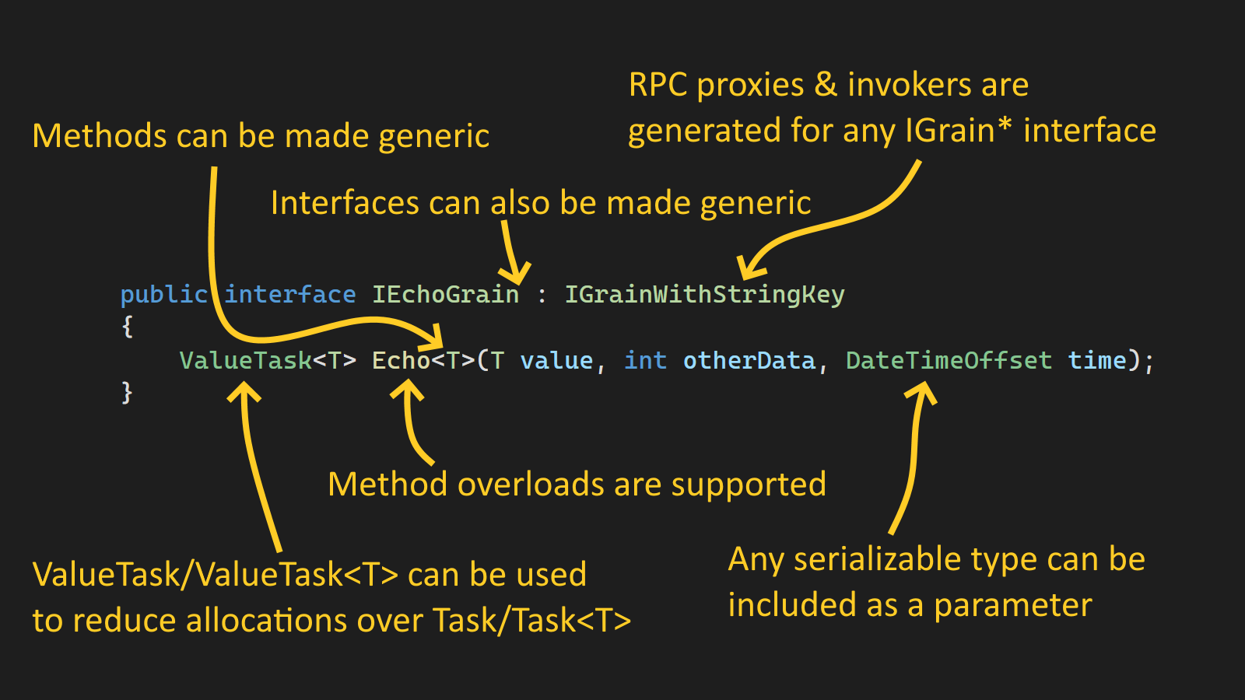

Slide 17
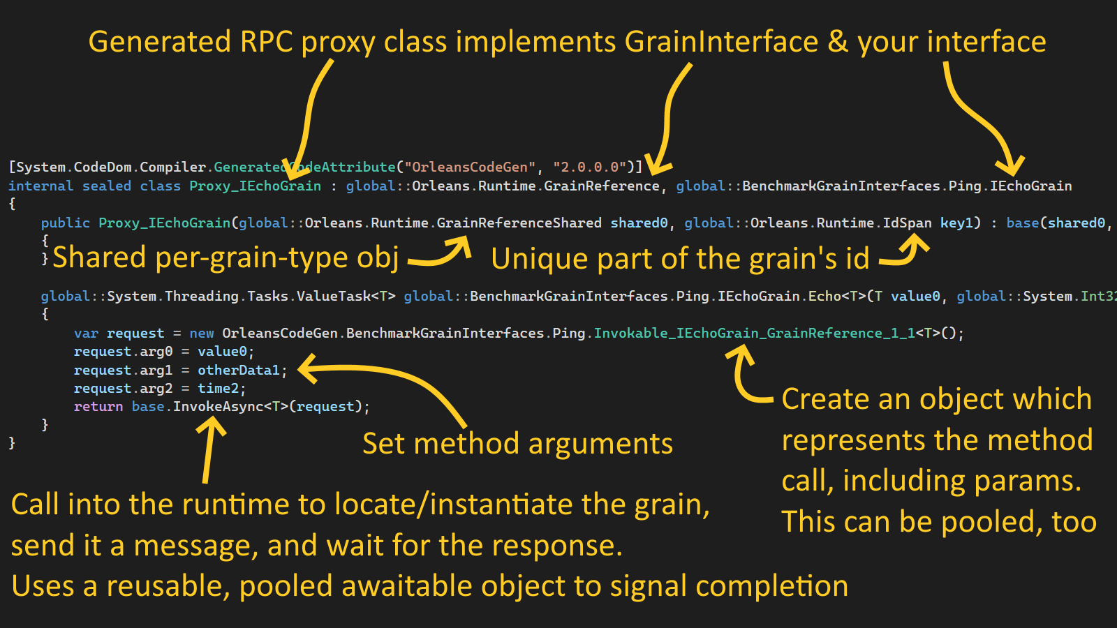

Slide 18
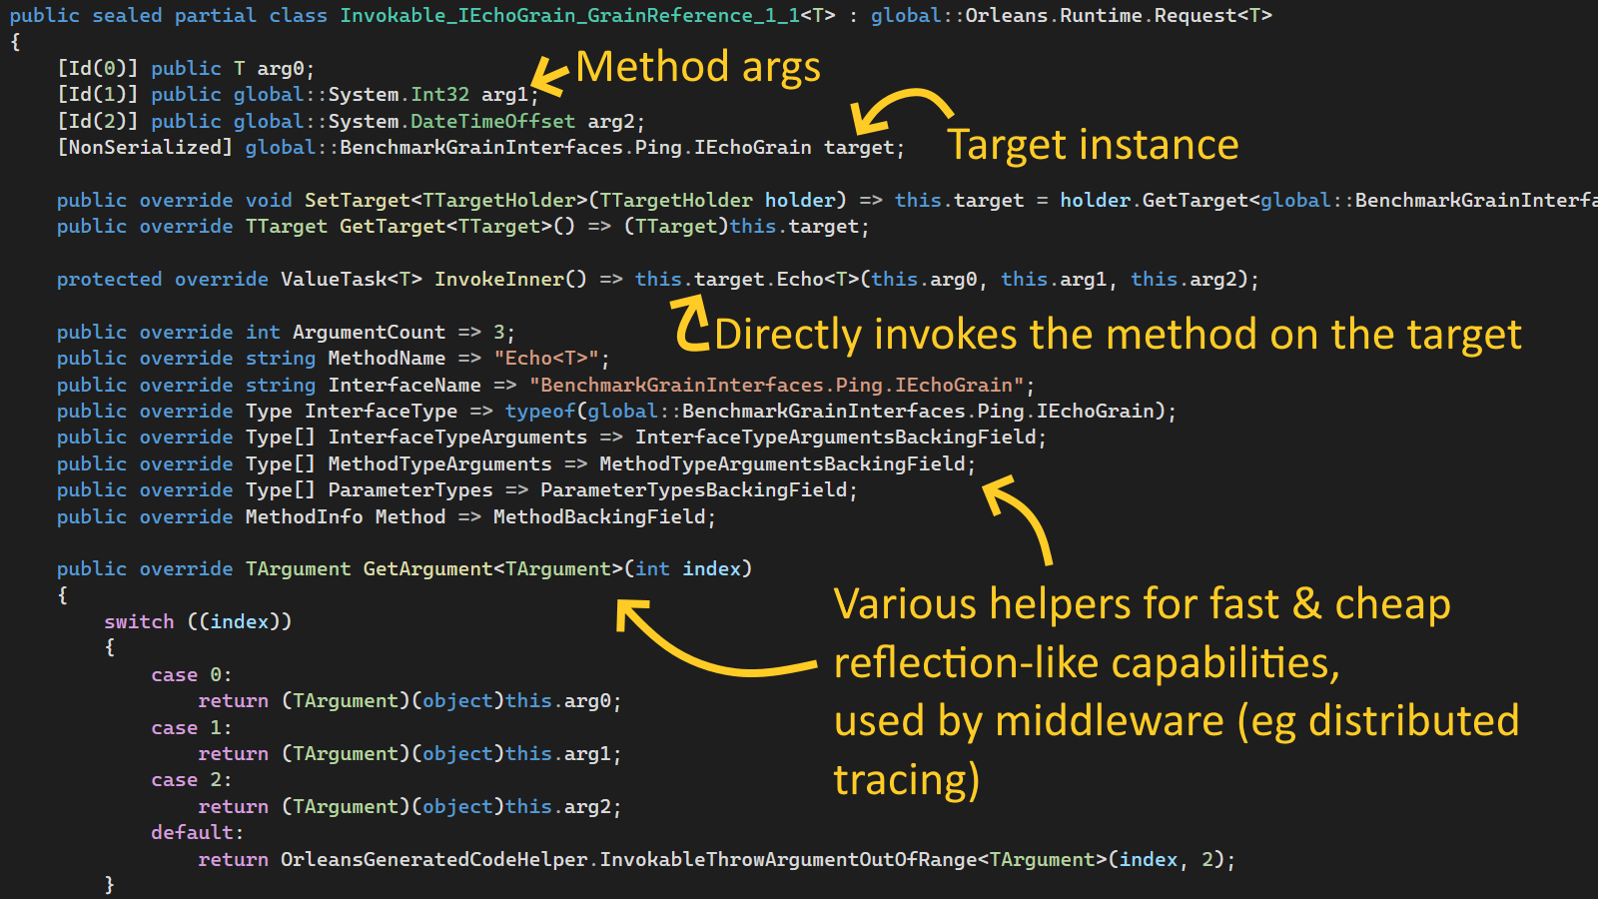

Slide 19
Serialization
Serialization is very important in Orleans
Any time an interface call needs to cross the process boundary, that involves serialization
Developers should be free model their types/interfaces as they see fit
We want to minimize the amount of ceremony
We do not want magic
Don’t serialize just any type, only known/allowed types
Version-tolerance requires a per-field id. Eg, [Id(0)]

Slide 20
Characteristics of Orleans’ serializer
Nominal types – polymorphism, generics
Type hierarchies – can add fields to base types without interfering with derived types
Reference cycles – for representing cyclic graphs
Version-tolerance – can add/remove fields, widen/narrow numeric fields, rename, etc, with defined rules on what’s supported
High-performance – fast and with minimal/no unnecessary memory allocations
No dependencies on Orleans itself
RPC – can serialize interface calls for later invocation

Slide 21
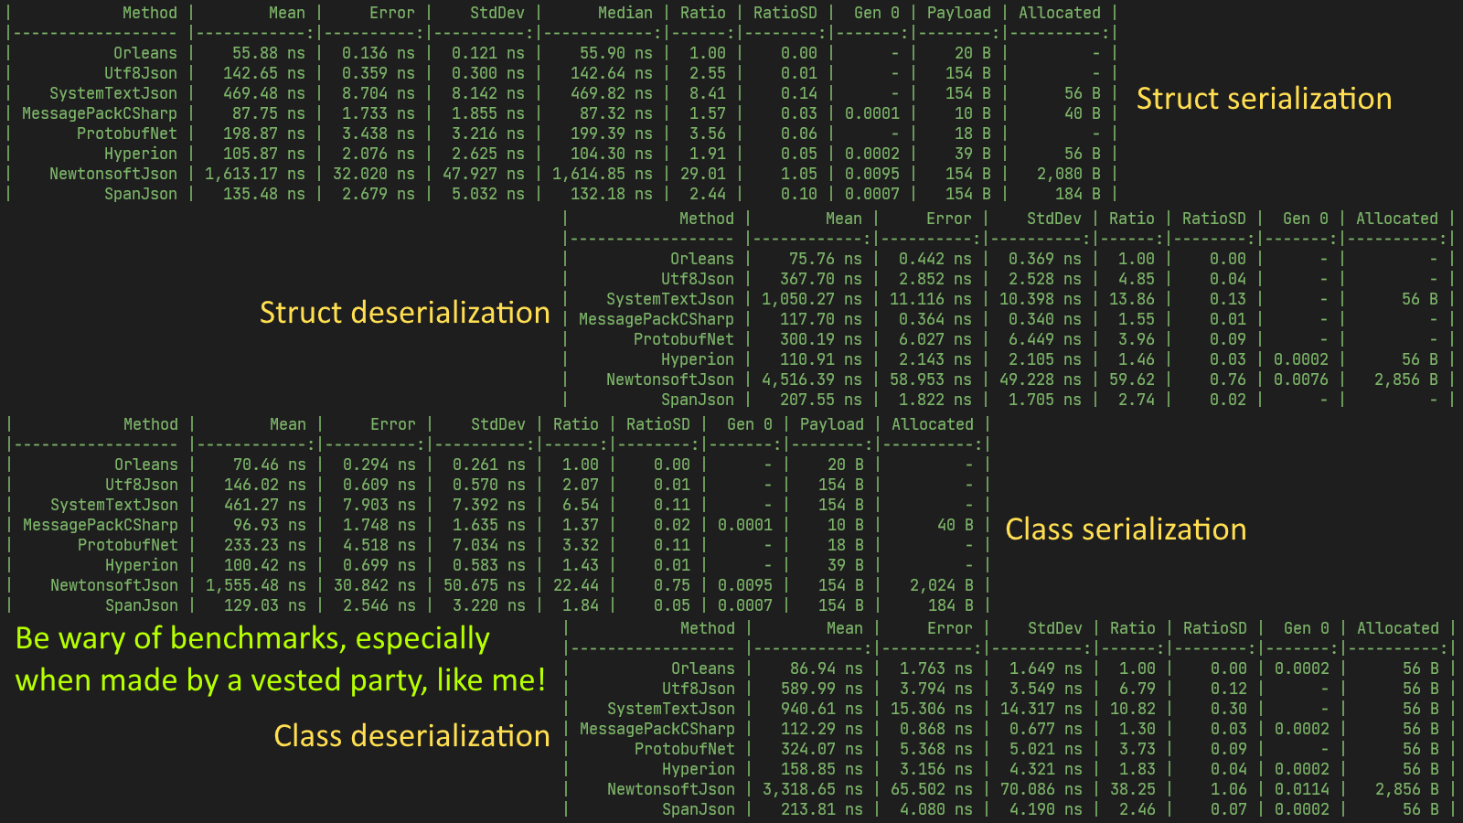

Slide 22
What makes it fast?
Type/interface design
Wire protocol design
Algorithmic choices
Optimizations

Slide 23
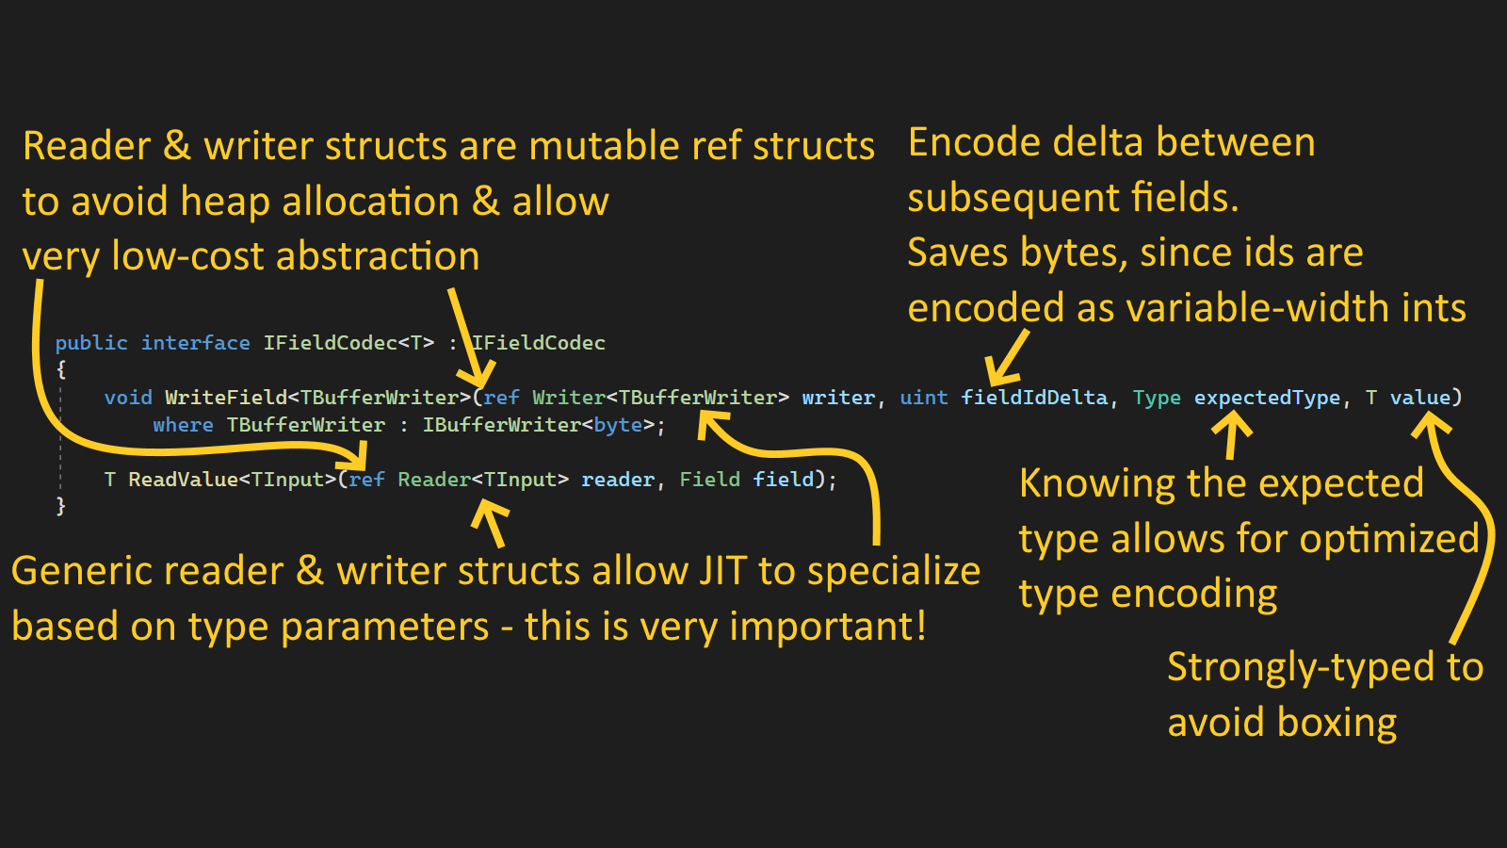

Slide 24
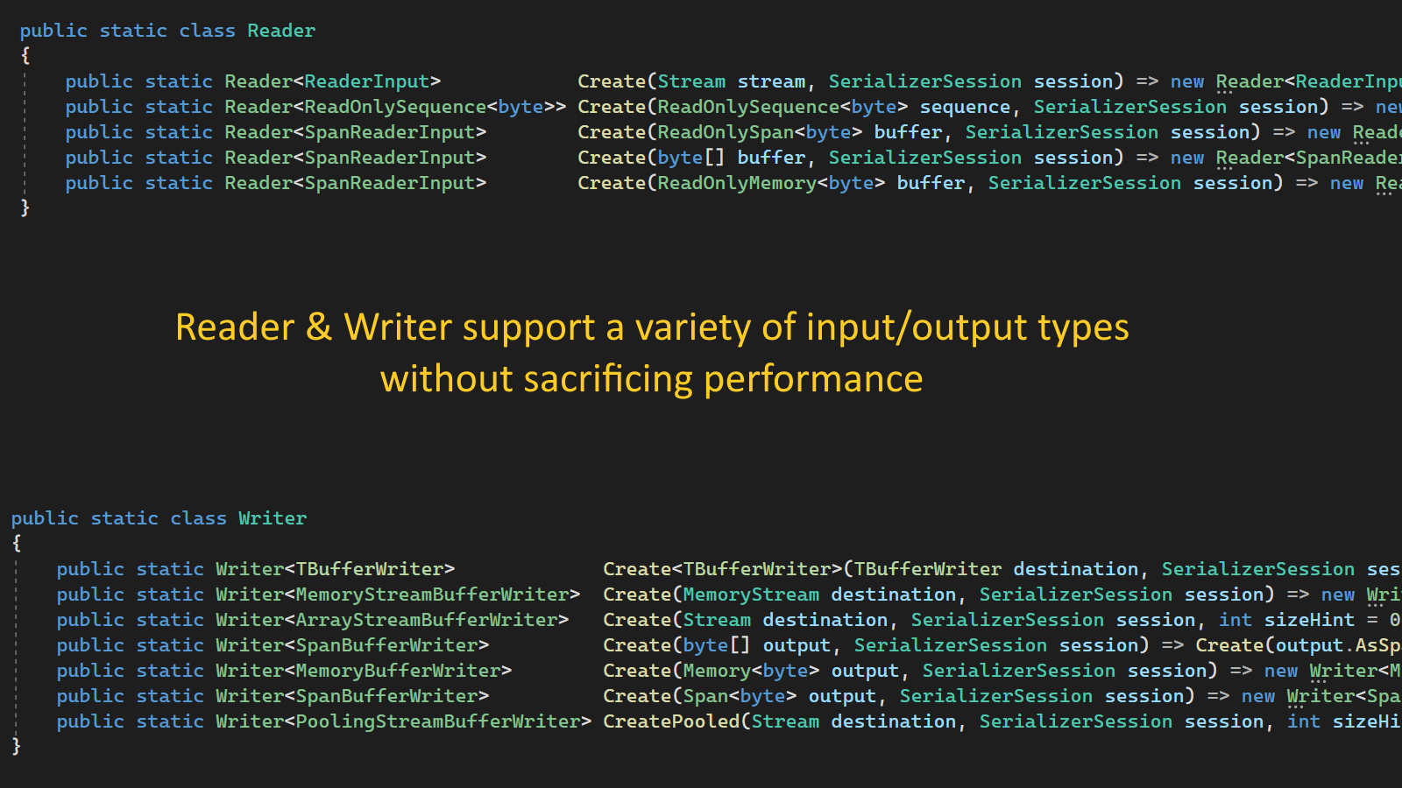

Slide 25
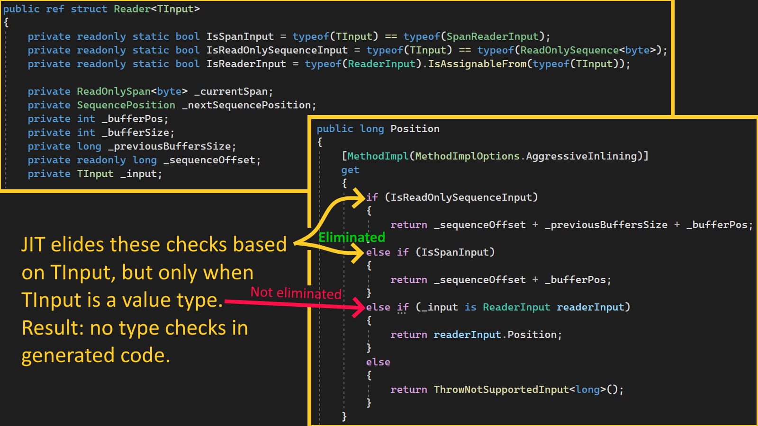

Slide 26
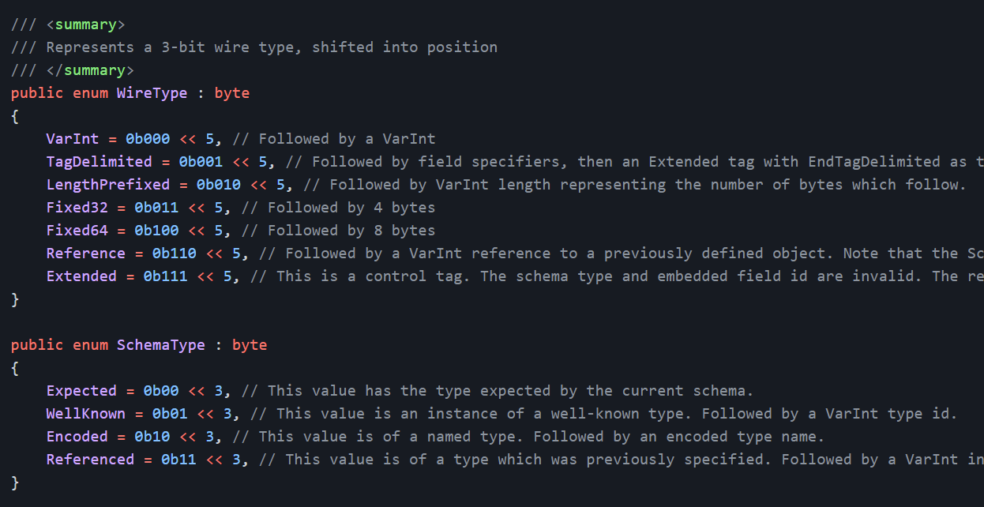
Serializer wire protocol design
Byte-sized tags followed by optional metadata, then payload
Tag + [SchemaType] + [FieldId] + [Data]
Compact representation
Separates encoding from the runtime type
Supports most common encodings
Can represent any .NET type, since type names can be encoded
Avoid encoding a value or type twice, by using references

Slide 27
Algorithmic choices
Protocol Buffers’ variable-length integer encoding is not fast
Basic algo: MSB in each byte indicates if another byte follows
Requires branches/loops ☹
We can store the length bits in the first byte(s) and reduce the perf cost
We can eliminate the need for branching instructions

Slide 28
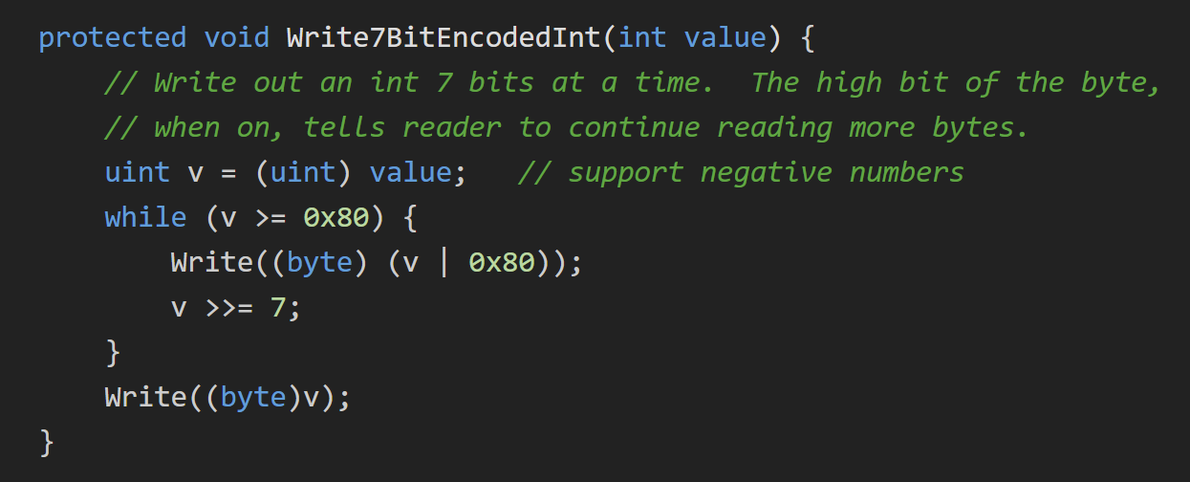
Baseline

Slide 29
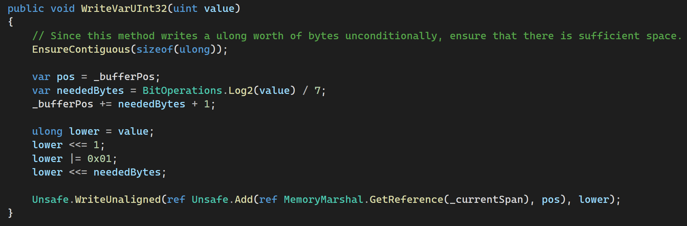
Optimized algorithm
Calculate the number of bytes needed
Move the write head by the required amount.
Only relevant for subsequent calls
Write a ‘1’ to delimit the data from the length suffix
Shift the result by the number of required bytes, resulting in a ‘0’ bit for every byte after the first
Write the result as one (potentially) unaligned 64bit value into the current span

Slide 30
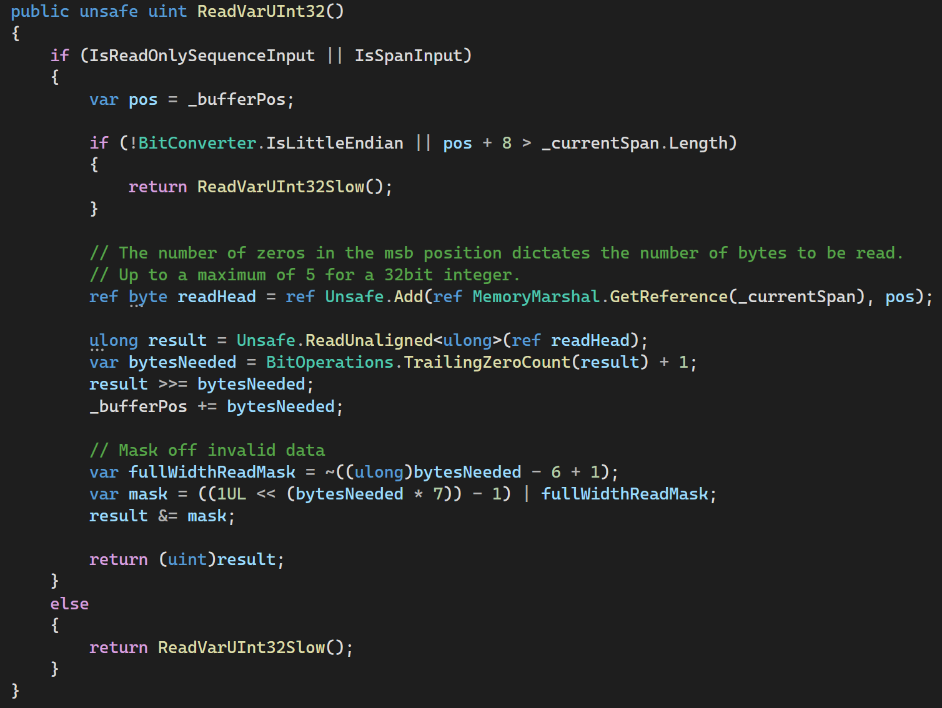
(1)
(2)
(3)
(4)
(5)
(6)
1. Read the raw value
2. Calculate the valid data length
3. Shift the result back into its original position
4. Move the read head to indicate we’ve consumed data
5. Compute a mask based on the valid data length
6. Mask-off the invalid data

Slide 31
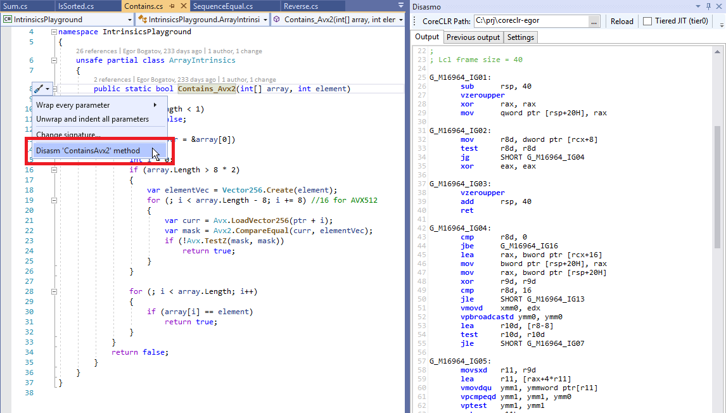
General optimizations
Reduce branching
Reduce memory allocation
Avoid boxing
Minimize virtual/interface calls
Maximize profitable inlining
Elide bounds checks
Precompute (partial) results
Avoid defensive struct copies
Use appropriate pooling
… etc
But only if you’re measuring constantly!
Some tips: https://reubenbond.github.io/posts/dotnet-perf-tuning
Ok, but how?
Measure, experiment, measure again.
Examine JIT output from BenchmarkDotNet or Disasmo VS extension
Disasmo

Slide 32
Source Generator
Goal: emit high-performance C# code
Can get complicated and messy!
Optimizes for well-known types like Int32, String, ...

Slide 33
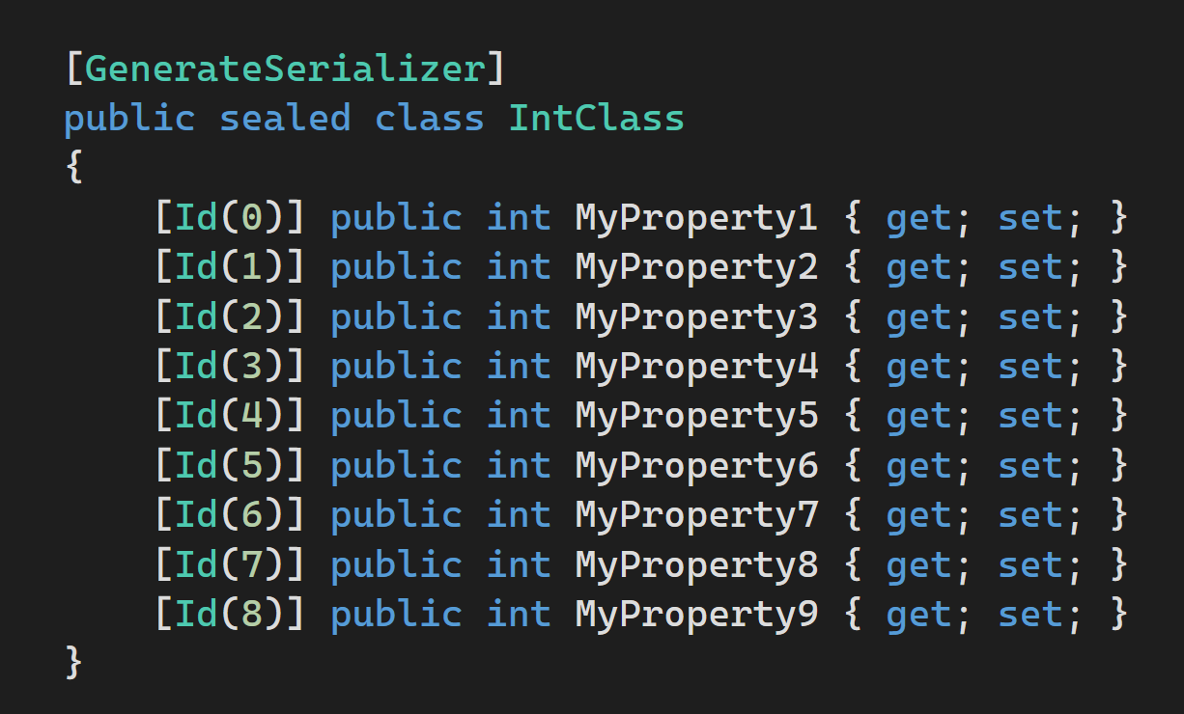
Our benhmark type

Slide 34
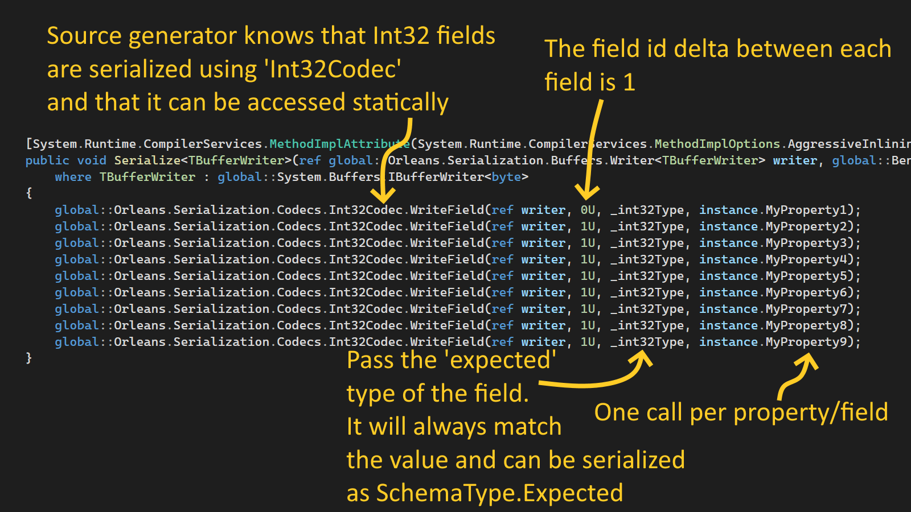

Slide 35
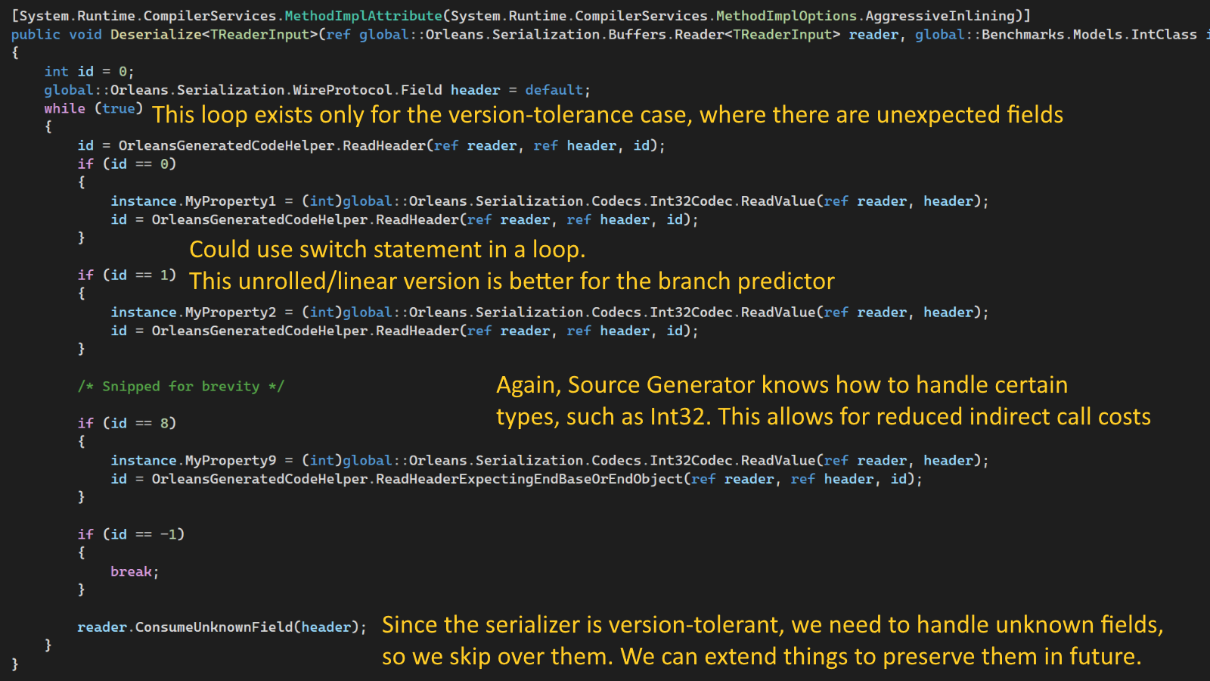

Slide 36
Features
Persistence
Plugins for Azure Storage, Cosmos DB, SQL, DynamoDB, Redis, MongoDB, …
Distributed ACID transactions
Read/write state in multiple grains transactionally
Virtual streams
Decouple producers & consumers. Backed by Azure Event Hubs, Amazon SQS, GCP, in-memory
Timers & reminders
Ephemeral timers, persistent reminders for scheduling future event
Observers
Grains can send events (RPC calls) directly to clients. Eg, push notifications, streams
Transport layer security
Mutual TLS between clients and the cluster as well as nodes within the cluster
Deployment freedom
Azure, AWS, GCP, on-prem, Kubernetes, Service Fabric, Windows, Linux, macOS
Custom placement & directory
Customize how the runtime decides where new grains are instantiated & how it finds them. “Move computation to data”
Call filters
Wrap incoming & outgoing requests & responses for logging, tracing, error handling
.NET integration
DI/Logging/Hosting/Configuration
Networking built on Project Bedrock

Slide 37
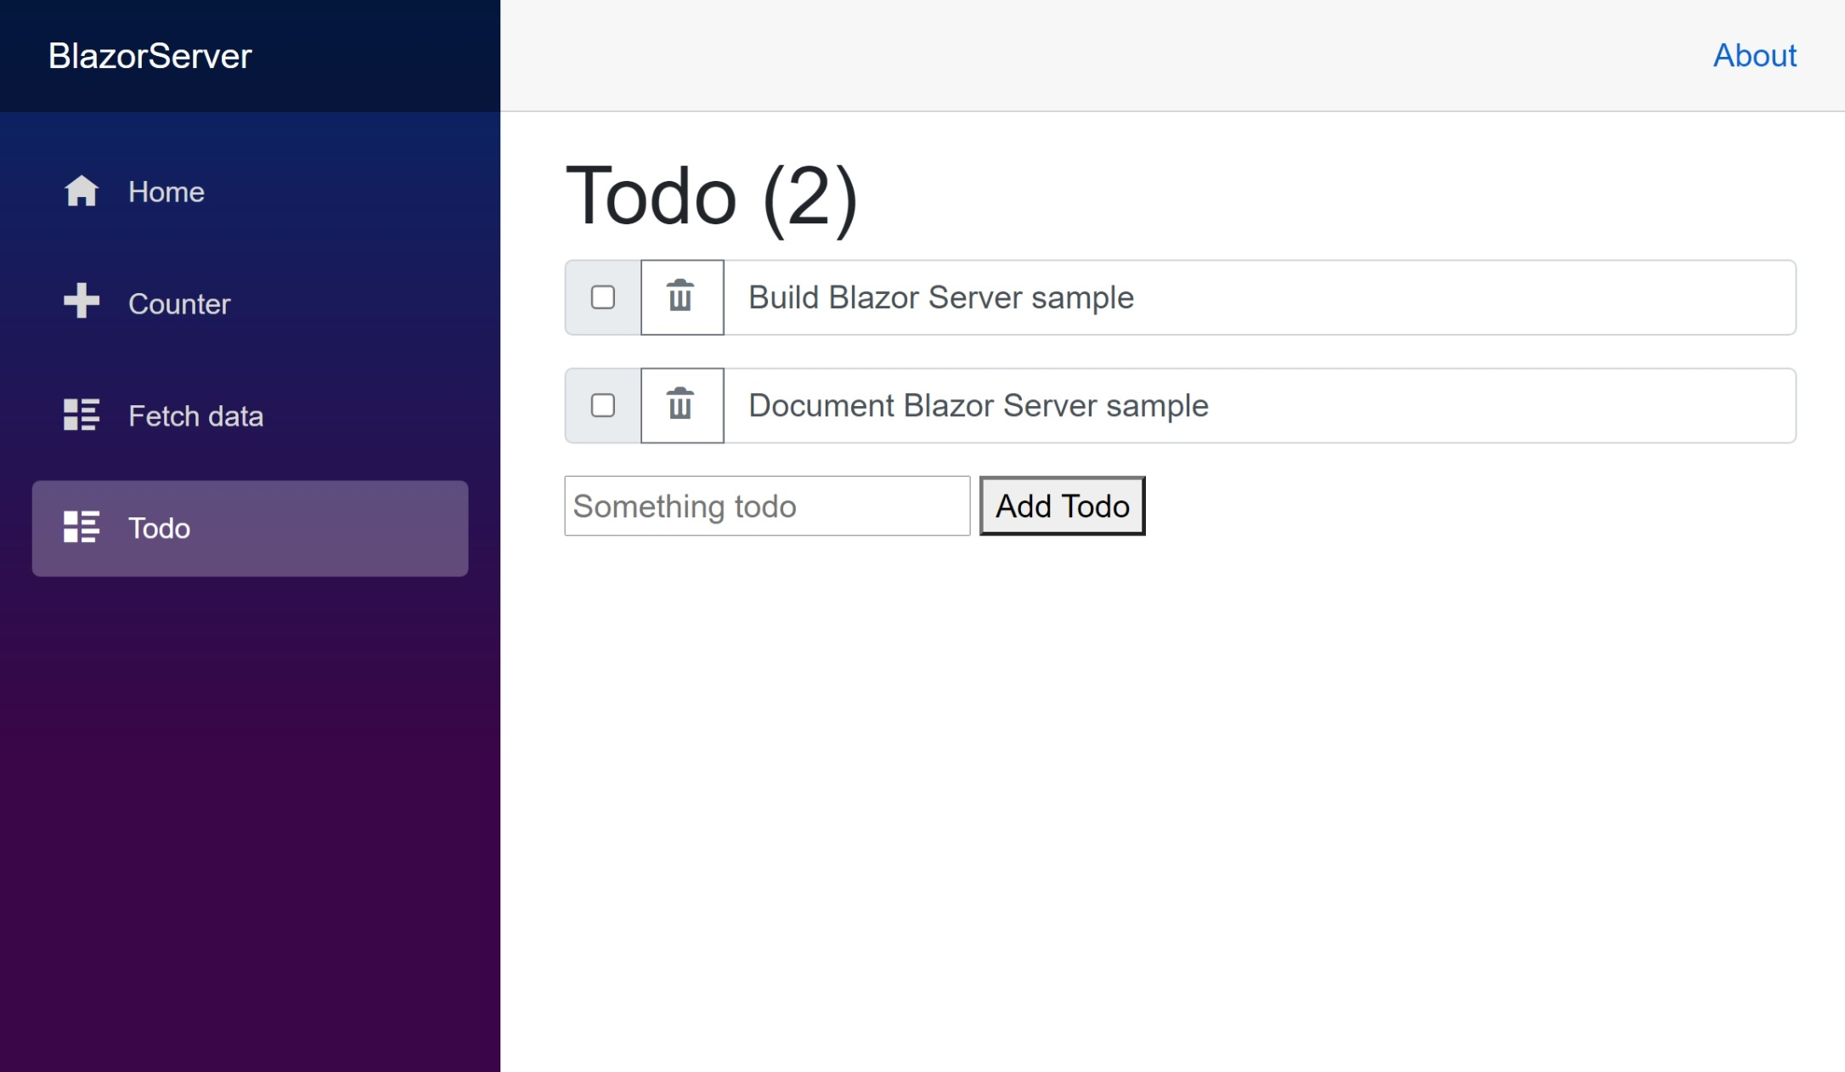
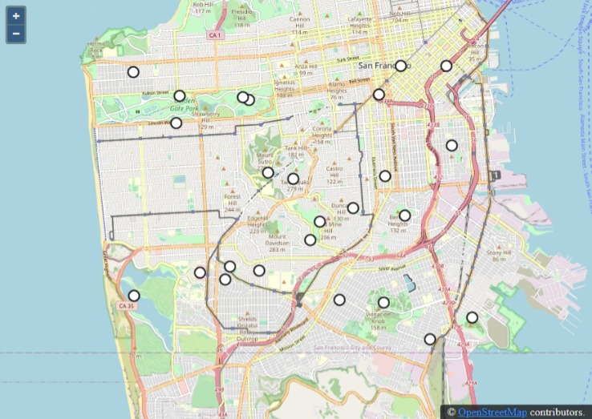
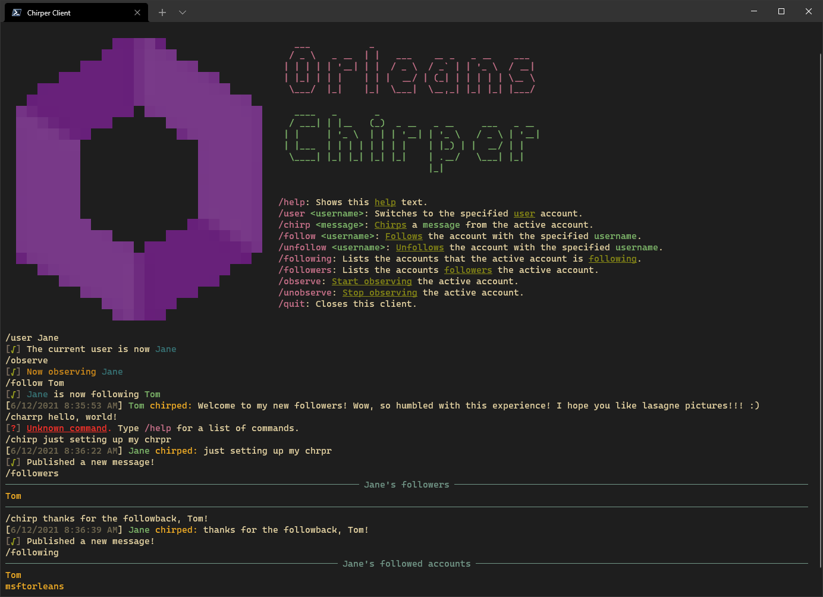
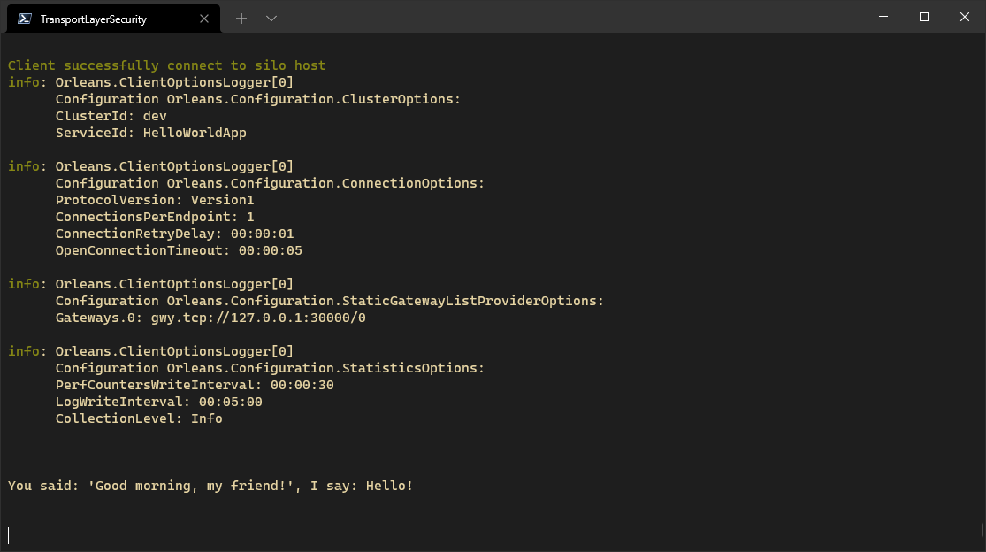
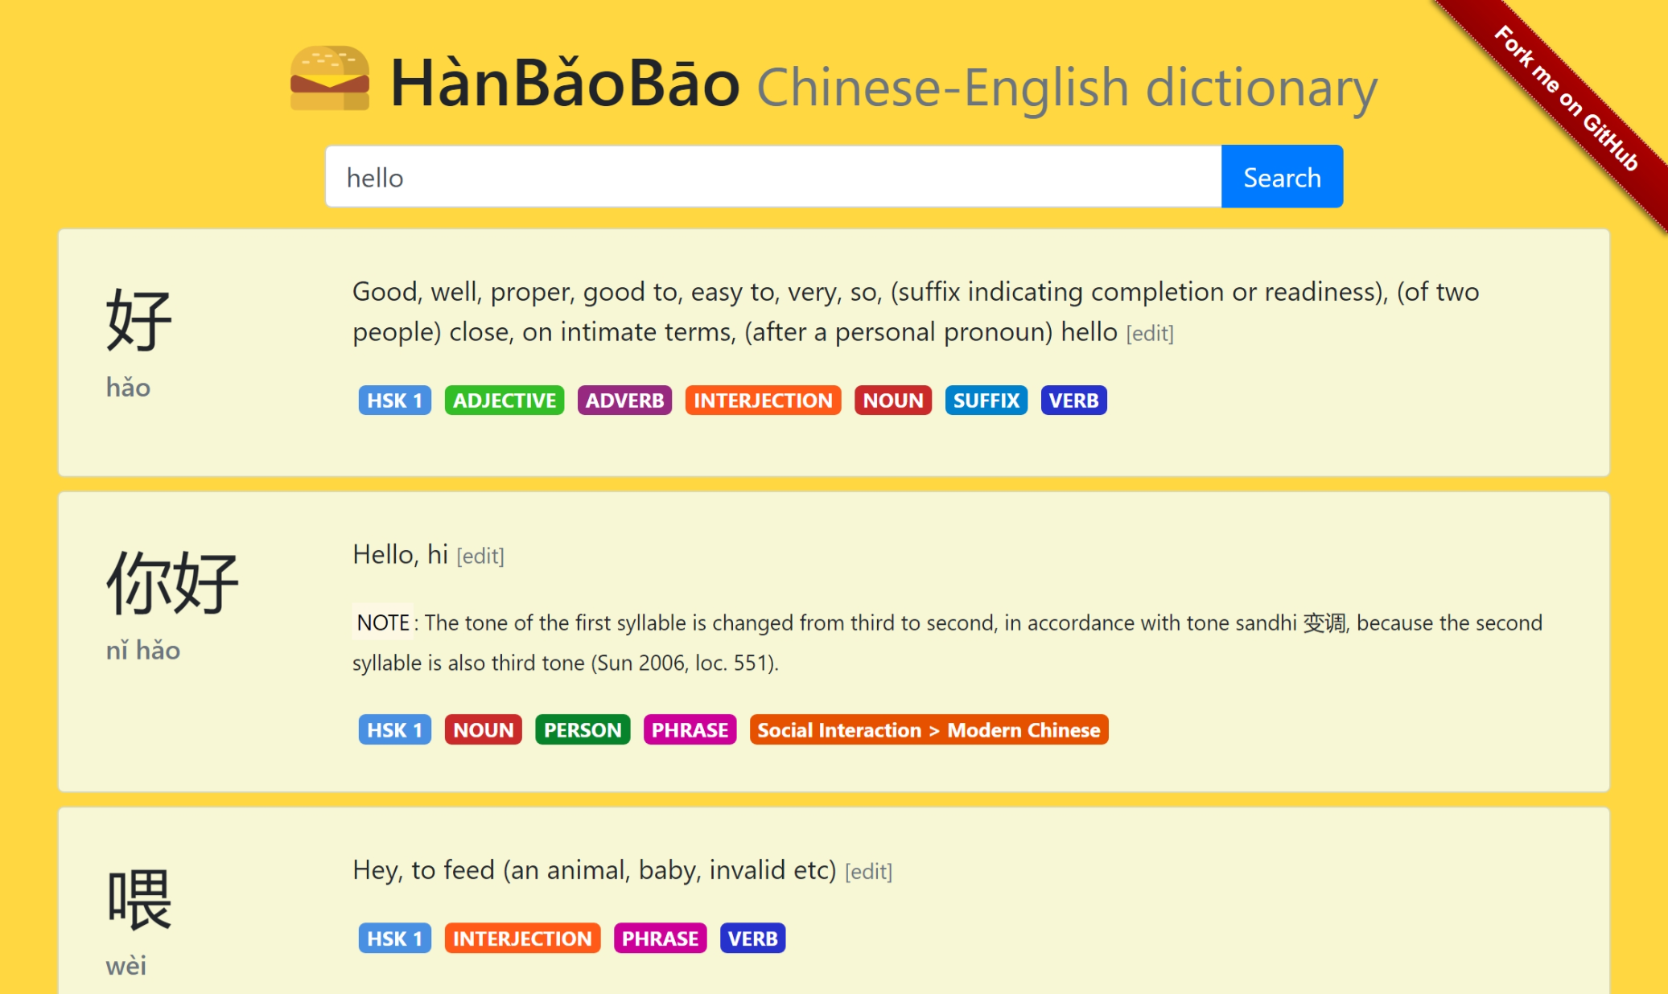
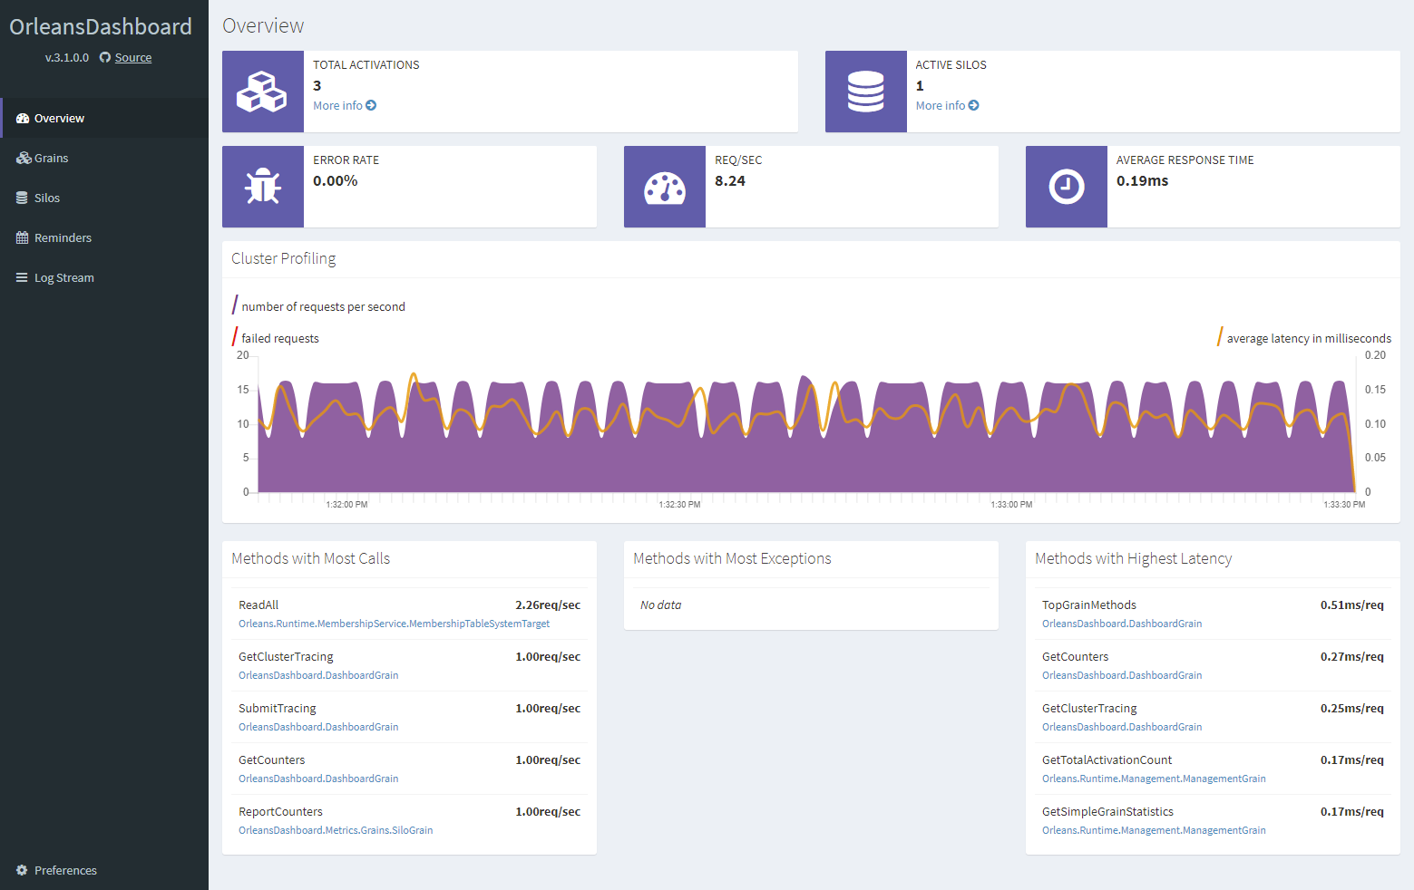
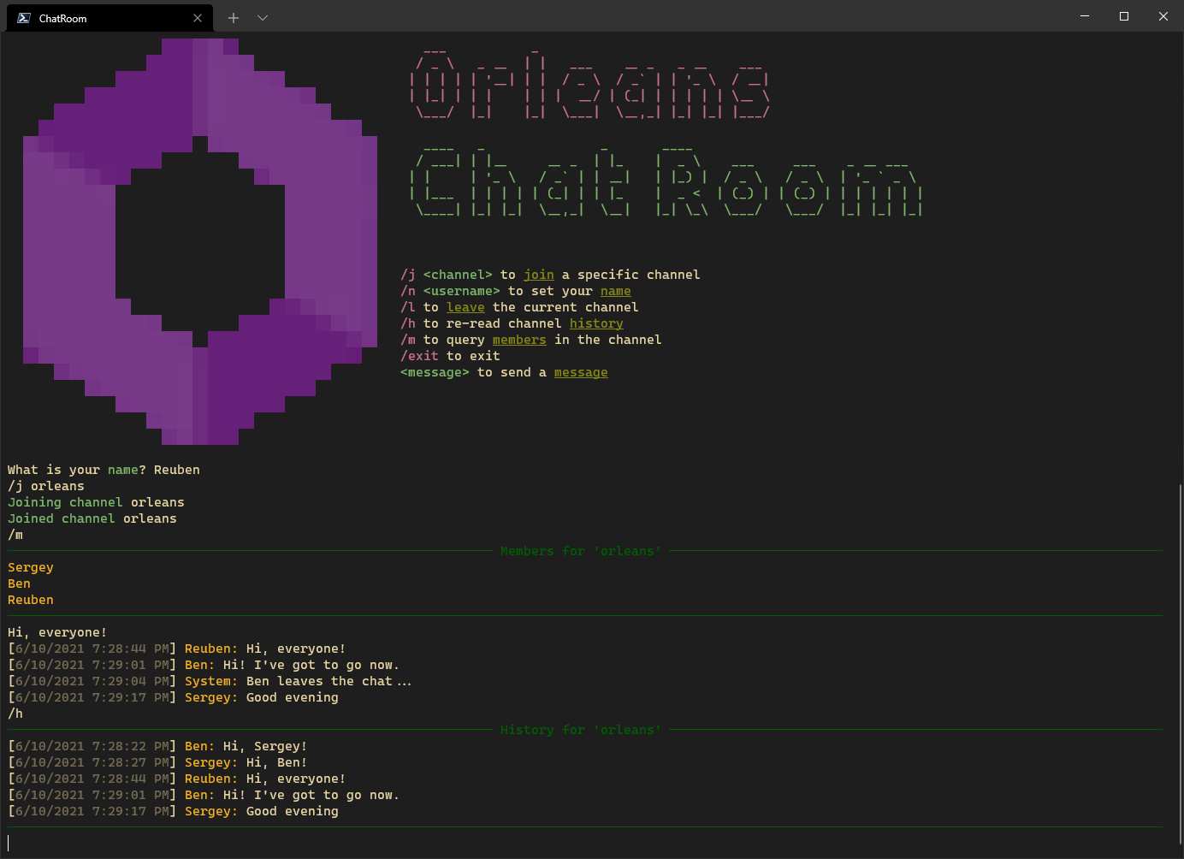
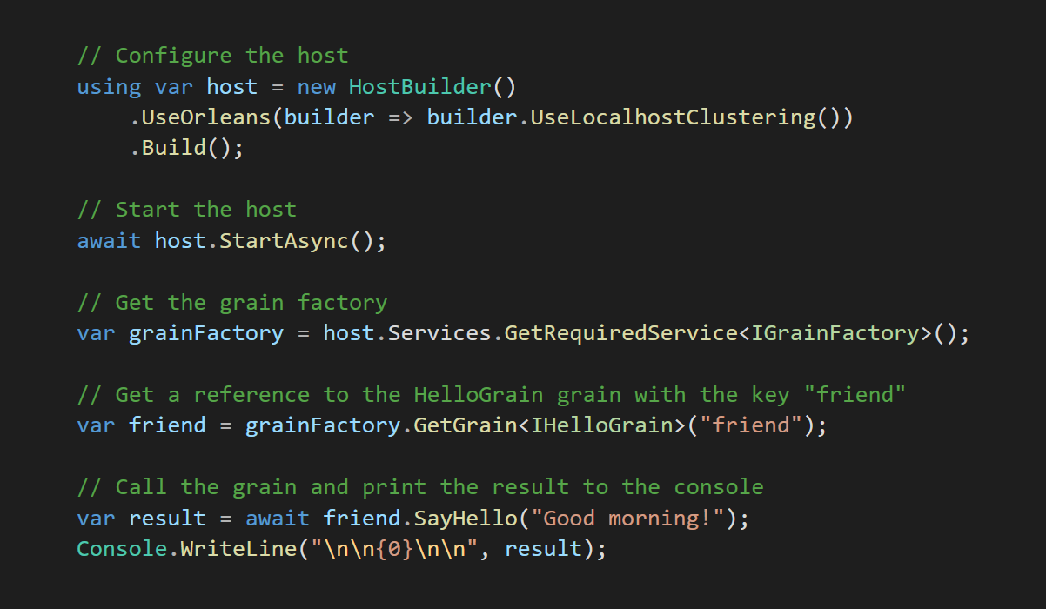

https://aka.ms/orleans-samples

Slide 38
Thank you!
Gitter: https://gitter.im/dotnet/orleans
GitHub: https://github.com/dotnet/orleans
Performance Tuning for .NET blog post: https://reubenbond.github.io/posts/dotnet-perf-tuning
@ReubenBond
@msftorleans

